Slide 1
Wearable Computing Systems eyeDrops
Lab Course 2016 / 2017
Marlene Fiedler
Lorenz Miething
Benjamin Thiemann
Albert-Ludwigs-Universität Freiburg
Notes:
Begrüßung
Name
Thema

Slide 2
Contents
Motivation
Project Idea
Plan A
Plan B
Plan C
Other possible applications
Project plan
Summary

Slide 3

Motivation
Dry eyes due to looking at computer monitor
→ increased probability of eye infections
→ damage of the corneal surface
→ itchy eyes
https://hylo.de/wp-content/uploads/2015/11/pc-arbeit-trockene-augen.jpg

Slide 4
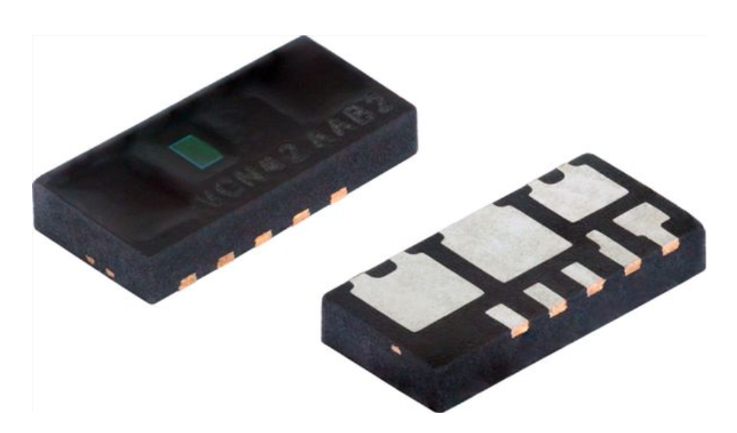
Idea
Sensor that detects blinking
Proximity Sensor
Light Sensor
Motion Sensor
http://www.vishay.com/docs/83476/vcnl4020.pdf
Notes:
http://www.vishay.com/docs/83476/vcnl4020.pdf

Slide 5
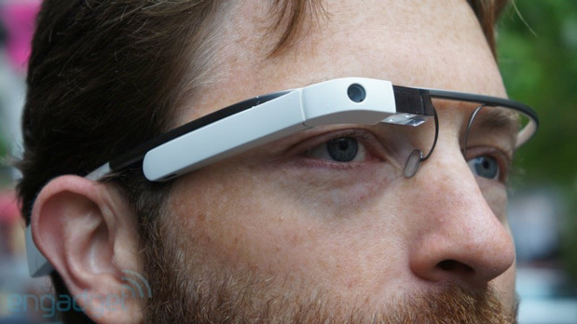
Idea
Sensor that detects blinking
Proximity Sensor
Light Sensor
Motion Sensor
Attached to eye glasses
https://www.blogcdn.com/www.engadget.com/media/2013/05/glasslead.jpg
Notes:
Explain that we want to attach the sensor to the wearers own glasses!

Slide 6
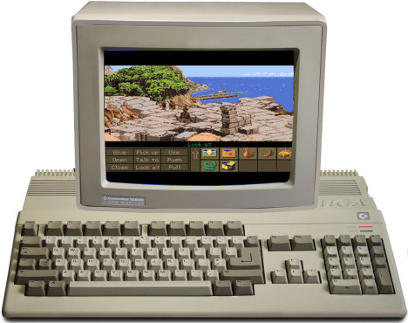
Idea
Sensor that detects blinking
Proximity Sensor
Light Sensor
Motion Sensor
Attached to eye glasses
Blurring of monitor to trigger blinking
http://www.chip.de/ii/770454642_c0a8e0f884.jpg

Slide 7
Plan A - best case scenario
Build reliable blink detection system
Distance or ambient light sensor
Proof of concept
Bluetooth communication
3D-printed casing
Software for all operating systems to blurr full screen
Power with solar cell
Survey to test system performance
Develop additional applications with „blink“ as input

Slide 8
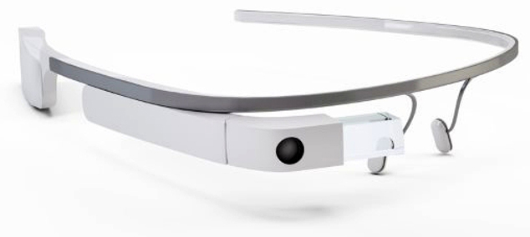
Plan B – alternative scenario
Use Google Glass instead of self built blink detector
Software for all operating systems to blurr screen
Focus on software and additional applications
Communication between Google Glass and PC
Blurr the screen
Additional applications
Survey to test system performance
http://betanews.com/wp-content/uploads/2015/01/google_glass-800x450.jpg

Slide 9
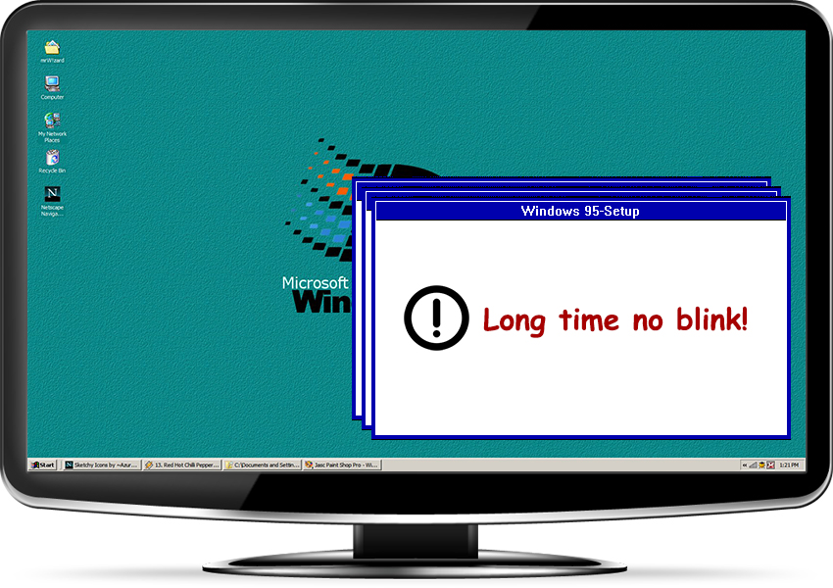
Plan C – worst case scenario
Use Google Glass instead of self built blink detector
Simplified software for one OS
http://betanews.com/wp-content/uploads/2015/01/google_glass-800x450.jpg

Slide 10
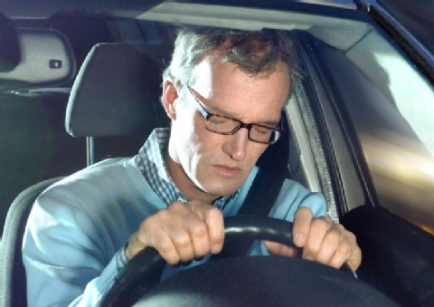
Other possible applications
Prevention of microsleep when driving
→ acoustic signal
Simple games
Input device for disabled people
http://partner.a-z.ch/partnersite/schweiz/jeder-fuenfte-verkehrsunfall-wegen-sekundenschlaf-100812548

Slide 11
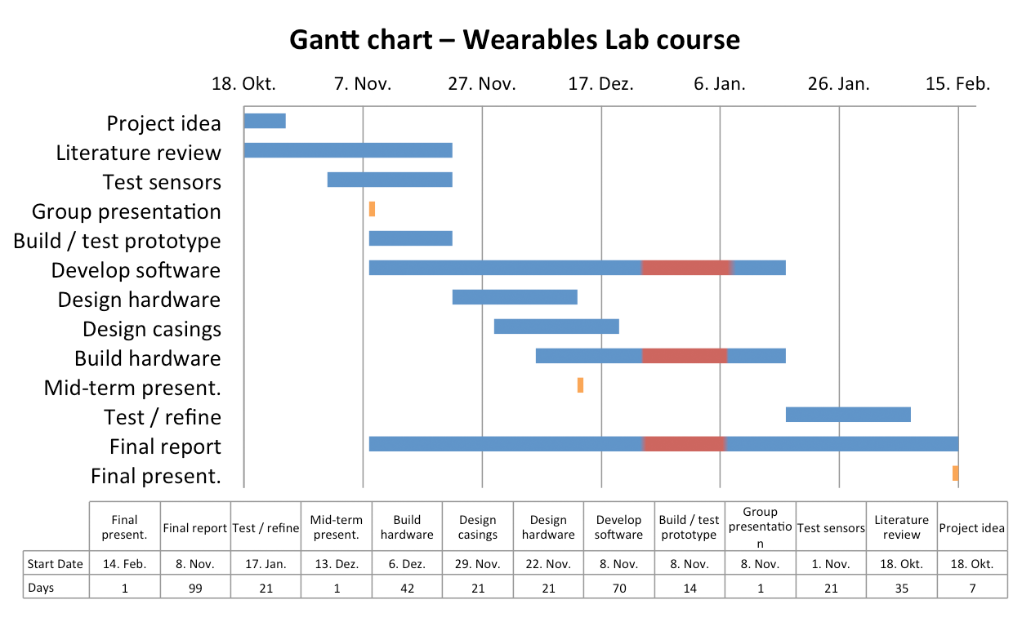
Project plan

Slide 12
Task distribution
Hardware design and building (Marlene, Lorenz)
Case design (Marlene)
Software design and development (Everybody)
RFDuino (Lorenz)
PC (Benjamin)
Project management (Benjamin)
Survey (Marlene, Benjamin)

Slide 13
Summary
Wearable blink detection system
Unconscious blink triggering
Long term protection against dry eyes
Use blink as input for various applications

Slide 14
Thank you for your attention!

